Slide 1


6
a) Write your press release!
The subject of the press release must be related to a product launch or the presentation of an upcoming event!
b) Create your business concept in one slide!

Slide 2
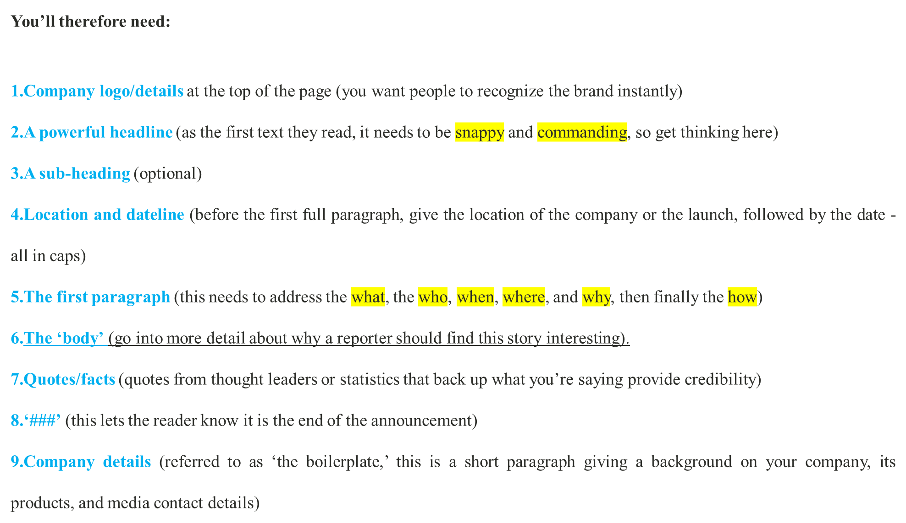


Slide 3
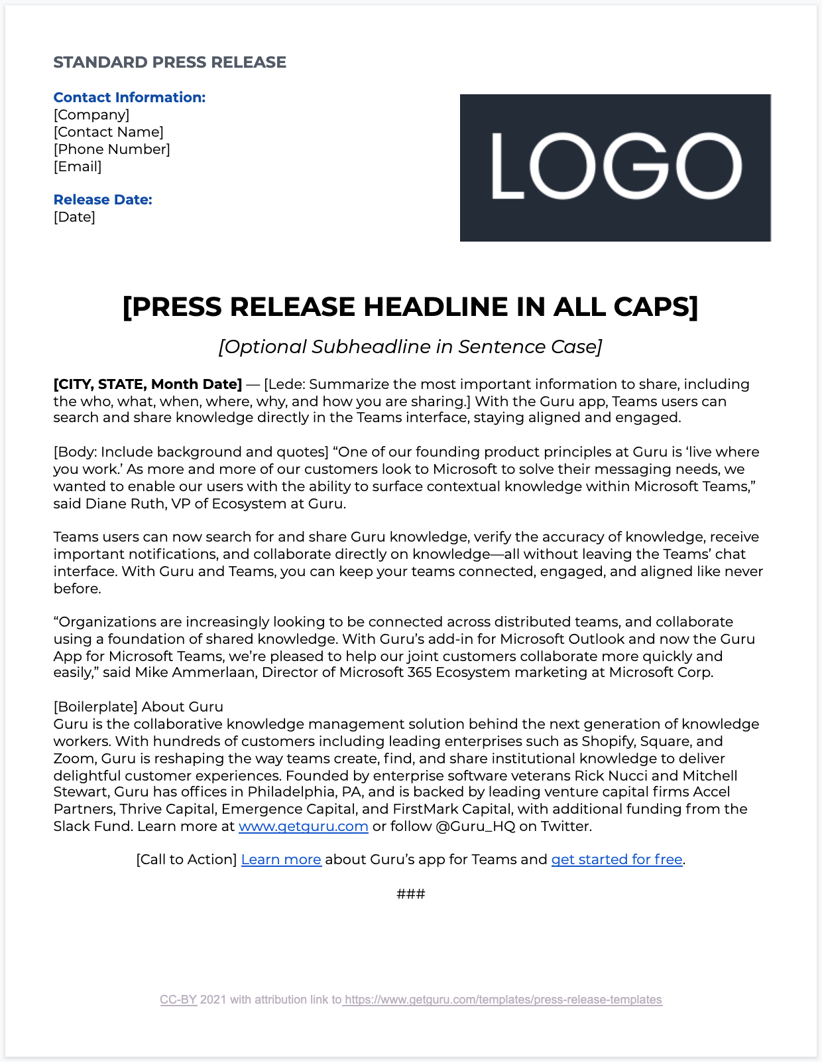


Slide 4
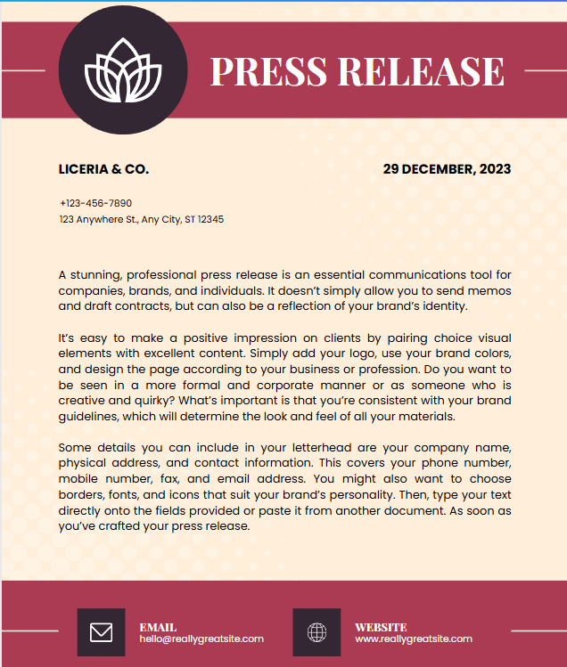

Slide 5
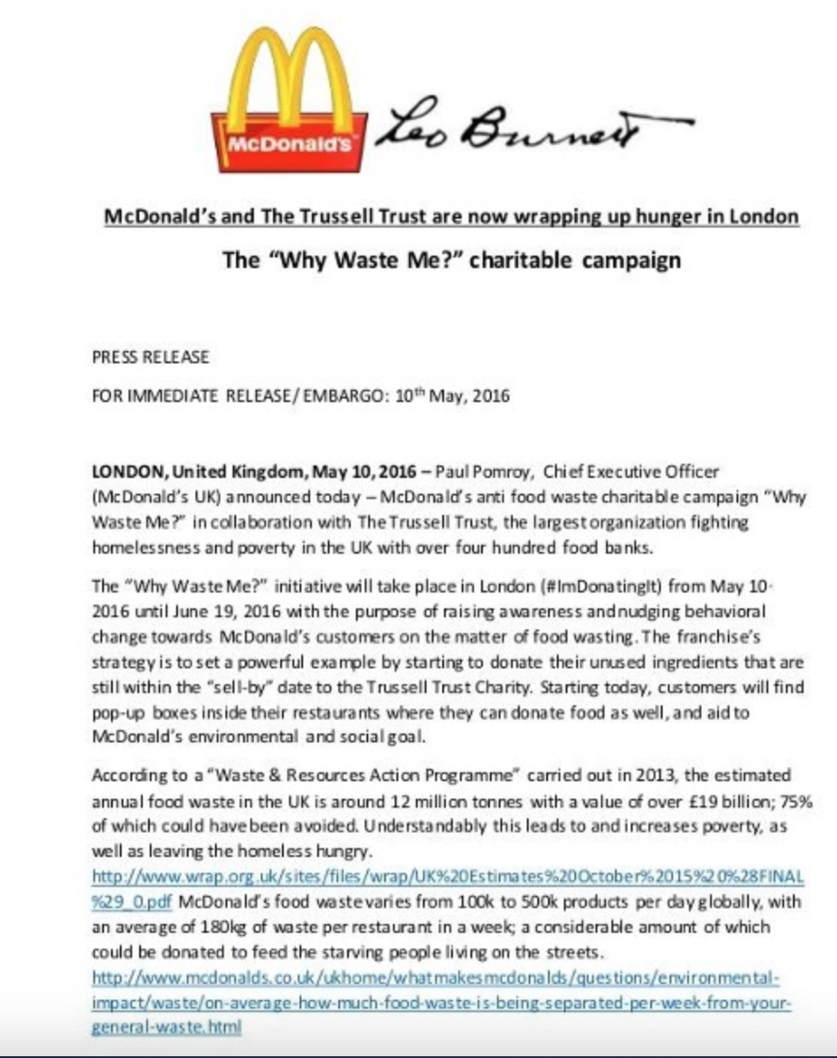

Slide 6
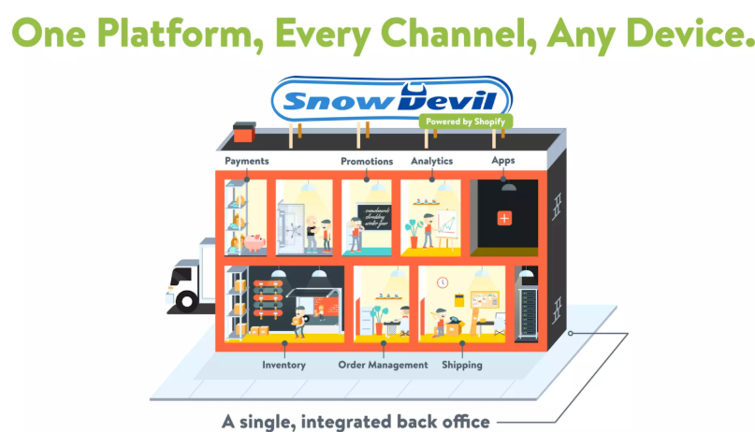
A business concept slide
Key takeaway: Shopify’s pitch deck explains the concept of their product with a great visual analogy. If you can do something similar — especially if your product is complex — it will help investors instantly understand what your product does.
https://plusai.com/blog/best-pitch-deck-examples-for-startups#toc-h2-2

